Slide 1
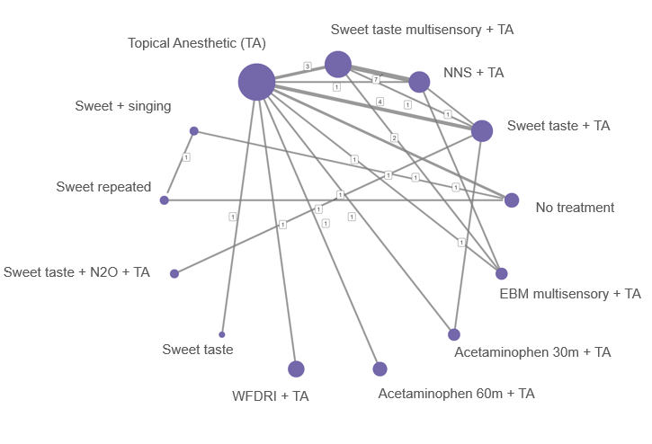
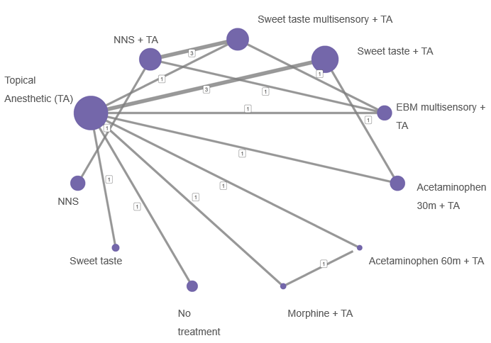
A
B

Slide 2
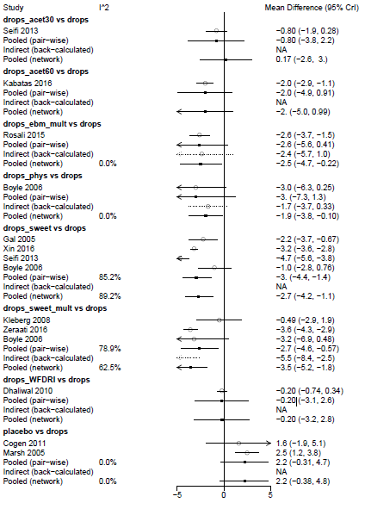
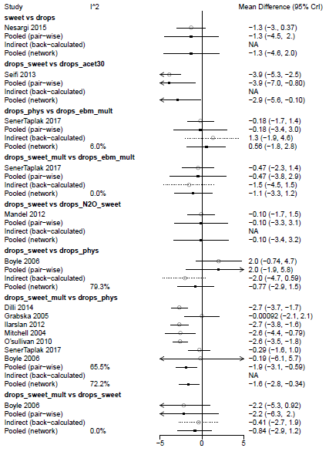
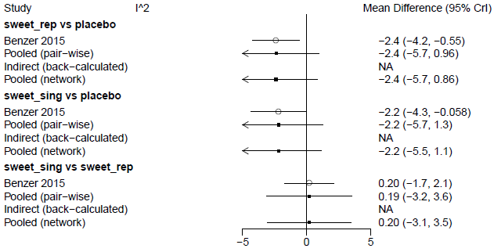
TA + Acetaminophen 30 min vs TA
Sweet taste alone vs TA
TA + Acetaminophen 60 min vs TA
Repeated sweet taste vs No treatment
Sweet taste + TA vs Acetaminophen 30 min + TA
EBM multisensory + TA vs TA
NNS + TA vs EBM multisensory + TA
Singing + sweet taste vs No treatment
NNS vs TA
Sweet taste multisensory + TA vs EBM multisensory + TA
Singing + sweet taste vs Repeated sweet taste
Sweet taste + TA vs TA
Sweet taste + TA vs Sweet taste N2O + TA
Sweet taste + TA vs NNS + TA
Sweet taste multisensory + TA vs TA
Sweet taste multisensory + TA vs NNS + TA
WFDRI + TA vs TA
No treatment vs TA
Sweet taste multisensory + TA vs Sweet taste + TA

Slide 3
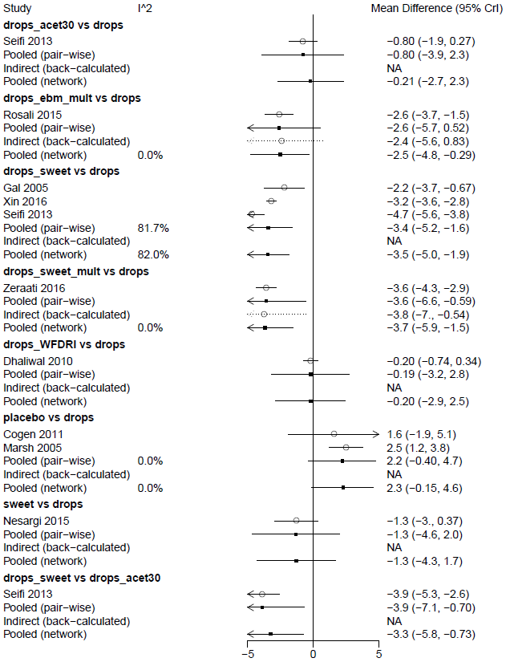
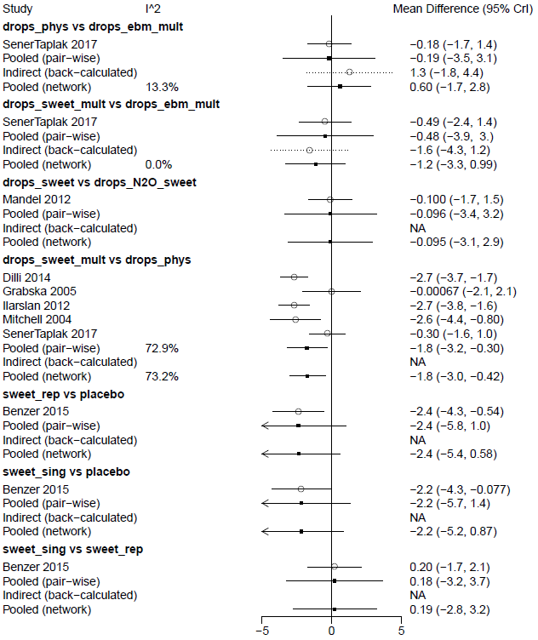
TA + Acetaminophen 30 min vs TA
NNS + TA vs EBM multisensory + TA
EBM multisensory + TA vs TA
Sweet taste multisensory + TA vs EBM multisensory + TA
Sweet taste + TA vs TA
Sweet taste + TA vs Sweet taste N2O + TA
Sweet taste multisensory + TA vs TA
Sweet taste multisensory + TA vs NNS + TA
WFDRI + TA vs TA
No treatment vs TA
Repeated sweet taste vs No treatment
Sweet taste alone vs TA
Singing + sweet taste vs No treatment
Sweet taste + TA vs Acetaminophen 30 min + TA
Singing + sweet taste vs Repeated sweet taste

Slide 4
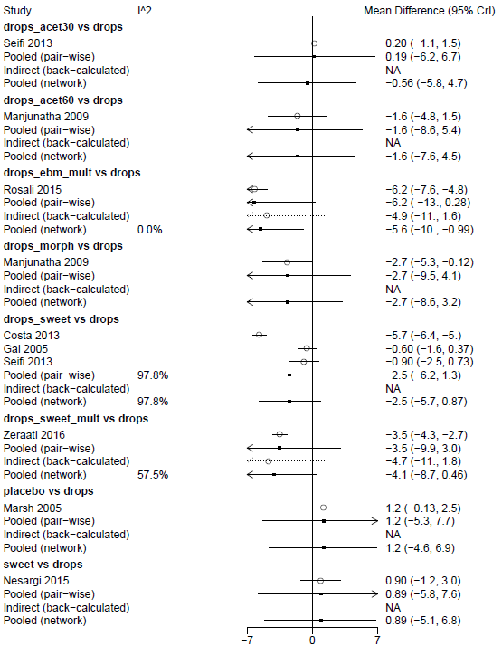
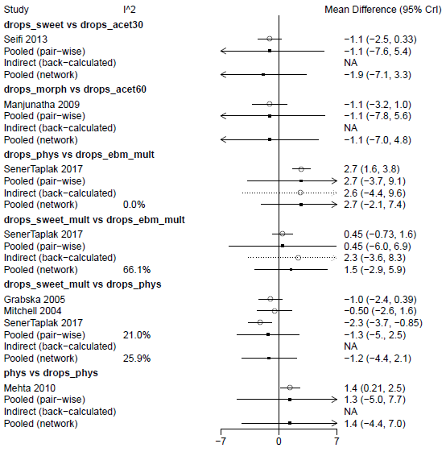
Acetaminophen 30 min + TA vs TA
Sweet taste + TA vs Acetaminophen 30 min + TA
Acetaminophen 60 min + TA vs TA
Morphine + TA vs Acetaminophen 60min + TA
EBM multisensory + TA vs TA
NNS+ TA vs EBM multisensory + TA
Morphine + TA vs TA
Sweet multisensory + TA vs EBM multisensory + TA
Sweet taste + TA vs TA
Sweet multisensory + TA vs NNS + TA
Sweet taste multisensory + TA vs TA
NNS vs NNS + TA
No treatment vs TA
Sweet taste alone vs TA

Slide 5
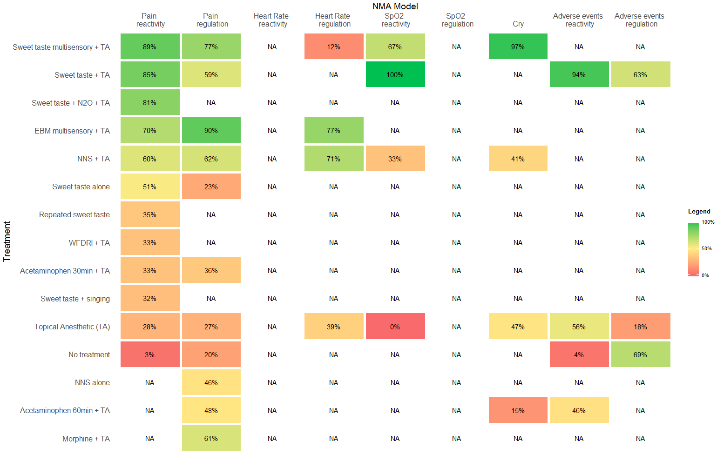
nStud = 16
N = 966
Type = RE
pDr = 1.01
SD = 1.09
nStud = 12
N = 693
Type = RE
pDr = 0.99
SD = 2.37
nStud = 2
N = 128
Type = FE
pDr = 1.00
SD = NA
nStud = 3
N = 215
Type = FE
pDr = 1.00
SD = NA
nStud = 4
N = 248
Type = FE
pDr = 1.67
SD = NA
nStud = 3
N = 204
Type = FE
pDr = 1.04
SD = NA
nStud = 2
N = 90
Type = FE
pDr = 1.06
SD = NA

Slide 6
nStud = 16
N = 966
nStud = 12
N = 693
nStud = 2
N = 128
nStud = 3
N = 215
nStud = 4
N = 248
nStud = 3
N = 204
nStud = 2
N = 90

Slide 7
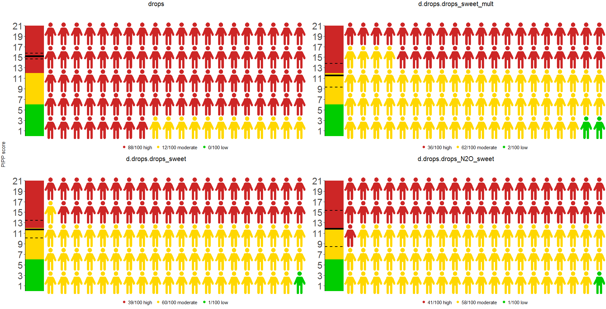
Topical anesthetic (TA)
Sweet multisensory + TA
PIPP Score
Sweet taste + TA
Sweet taste + N2O + TA

